Slide 1
The ocean carbon cycle
Silvia Caldararu
Email: caldaras@tcd.ie

Slide 2
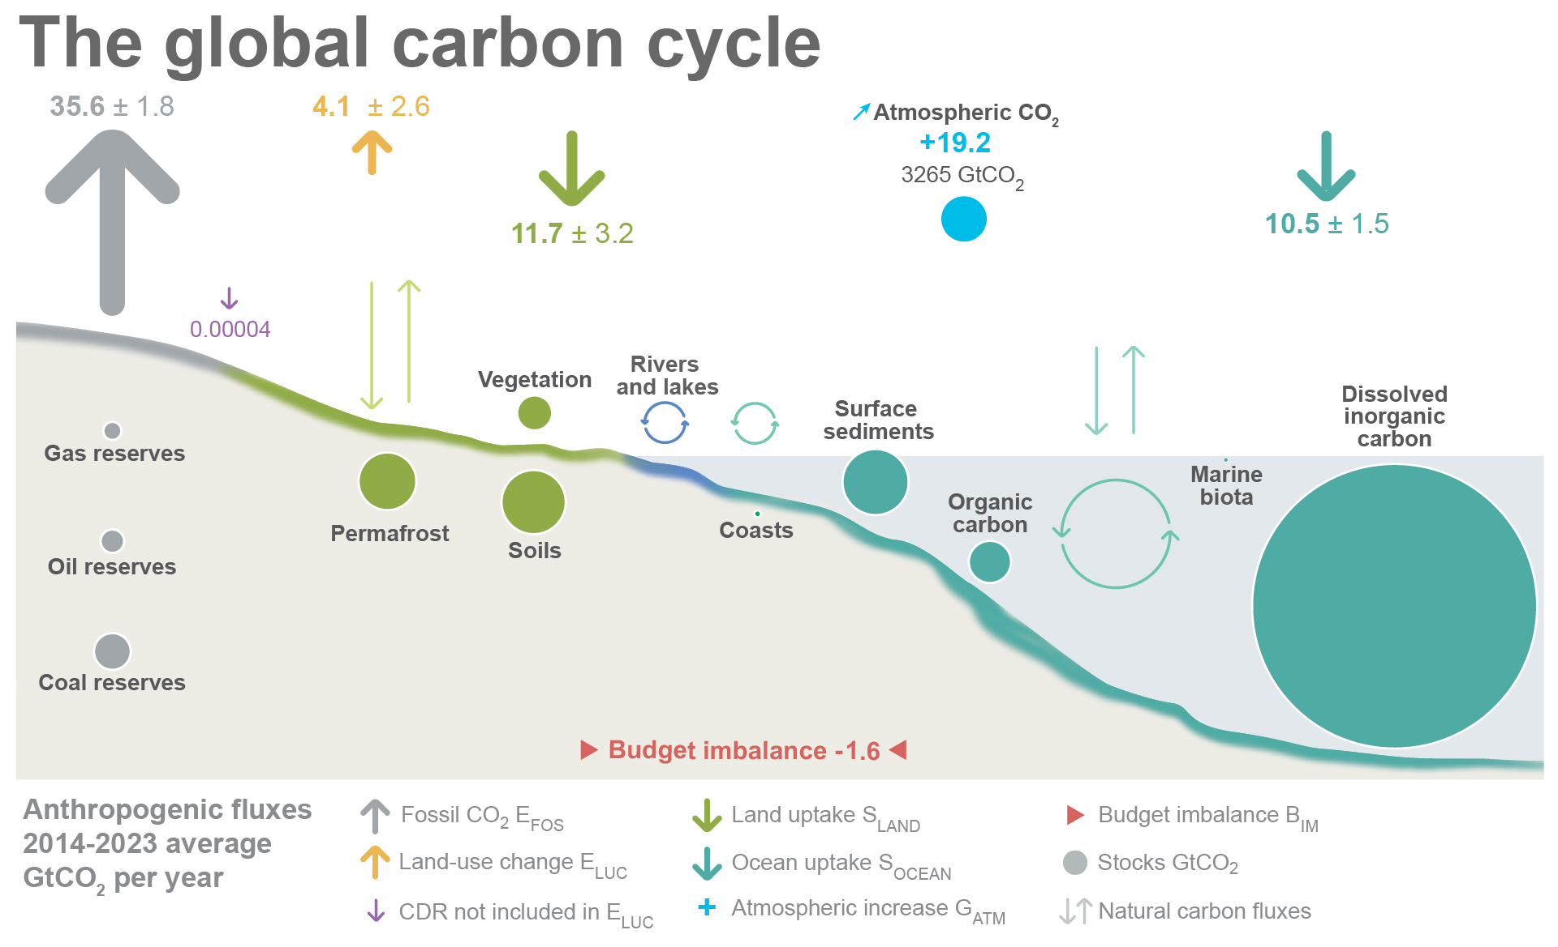

Slide 3
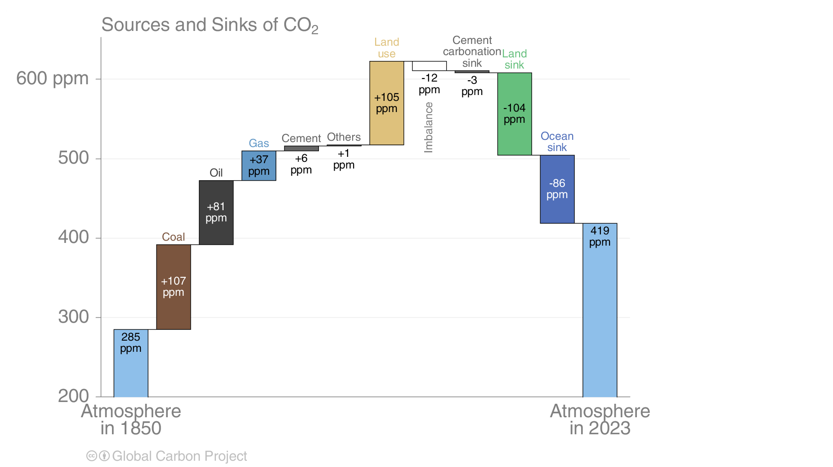

Slide 4
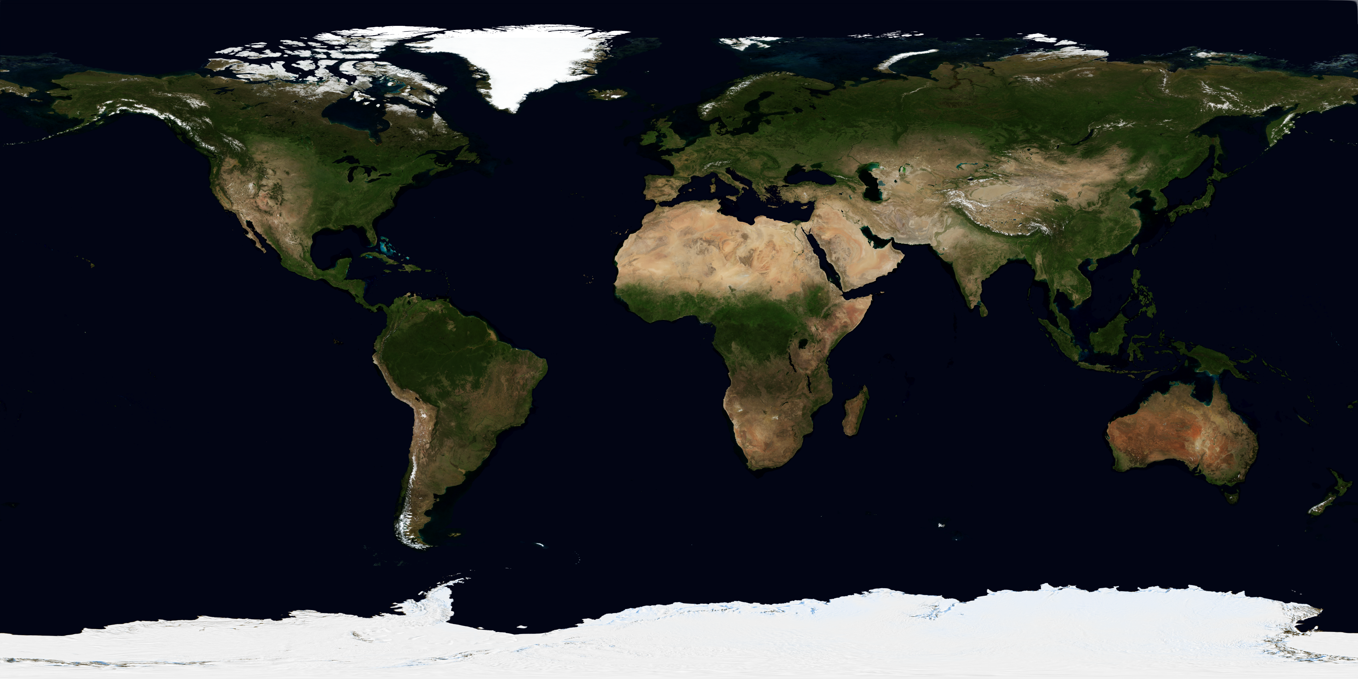
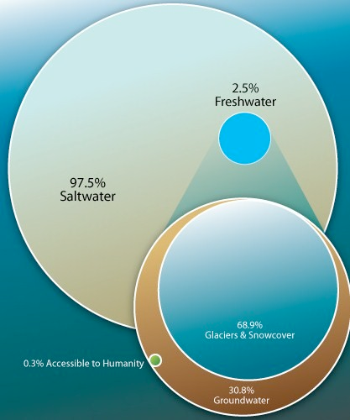
70% of the Earth’s surface is ocean

Slide 5
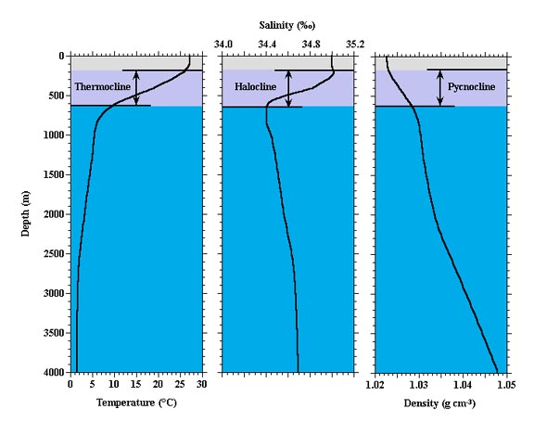
Ocean vertical structure
Solar radiation
Ocean waters are heated from above by solar energy. The temperature is highest in the top layer and decreases rapidly with depth.
Thermocline – area between the well-mixed surface layer and the deep water

Slide 6
Ocean vertical structure
Sea water contains dissolved minerals whose concentration is expressed as salinity. The vertical profile is driven by temperature-solubility relationships.
Halocline is a layer of rapidly changing salinity

Slide 7
Ocean vertical structure
Water density varies with temperature and salinity

Slide 8
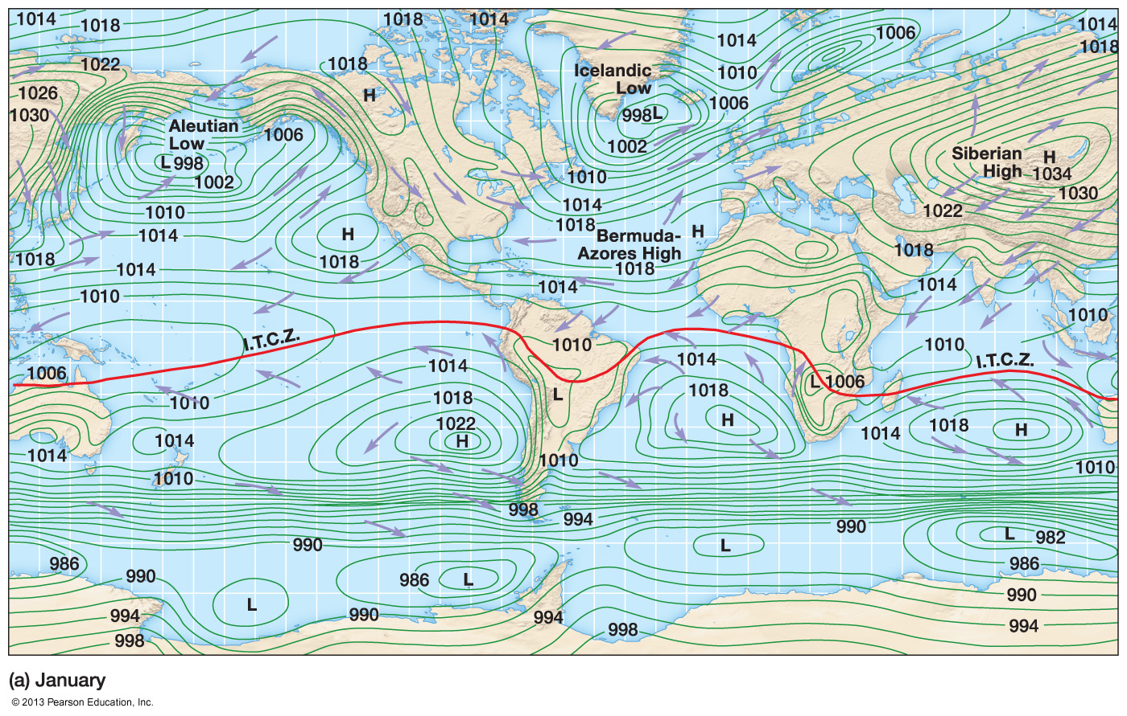
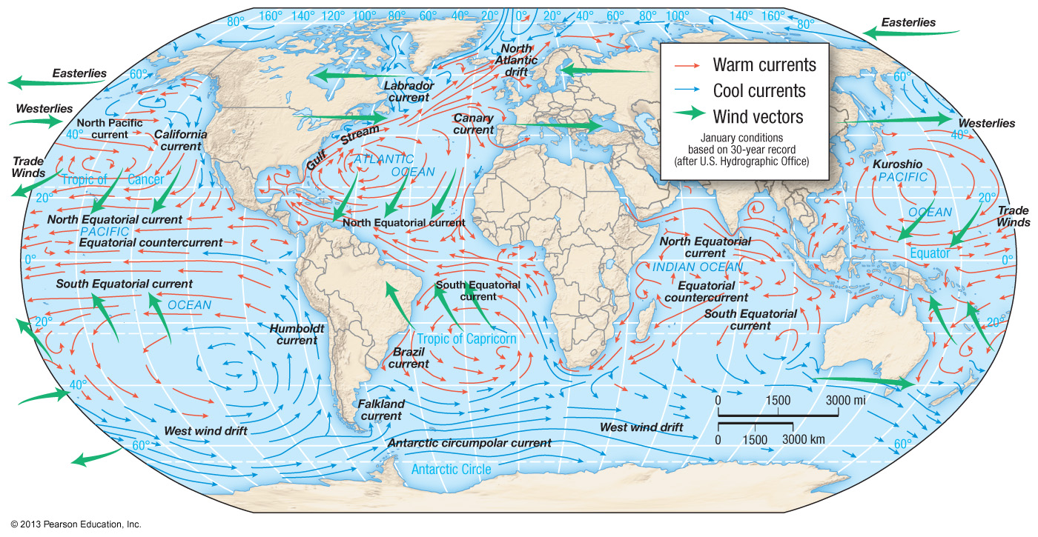
Surface ocean currents
Ocean circulation
Atmospheric circulation

Slide 9
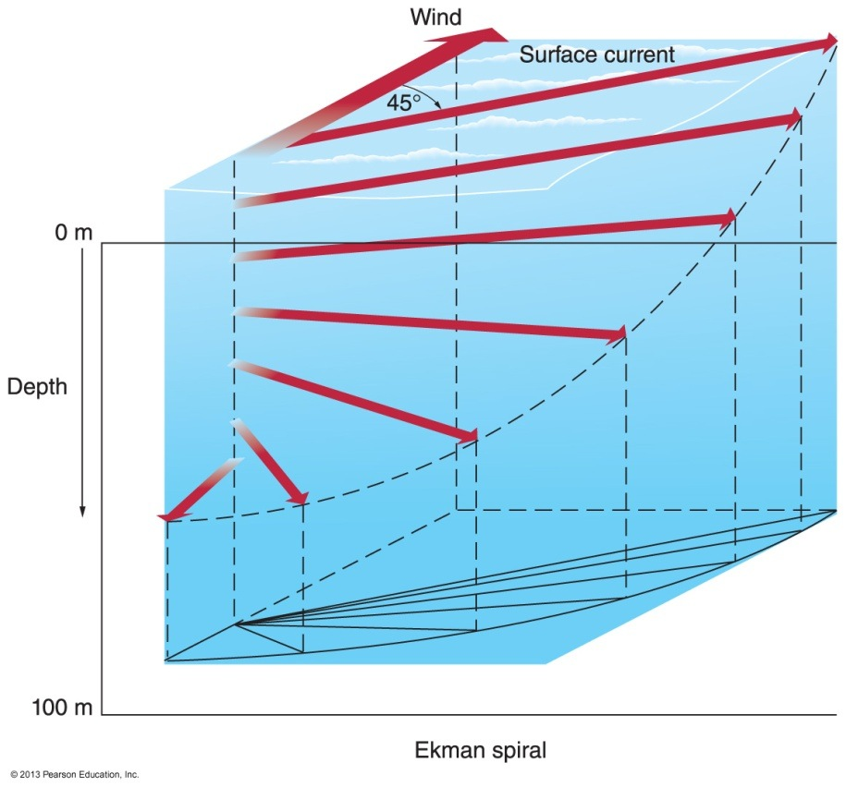
Ocean currents: Eckman spiral
Surface layer deflected by Coriolis force with lower effect on subsequent layers
Deeper layers moved and deflected by friction

Slide 10
Global ocean circulation

Slide 11
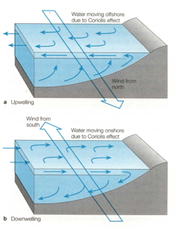
Vertical water movement: upwelling and downwelling

Slide 12
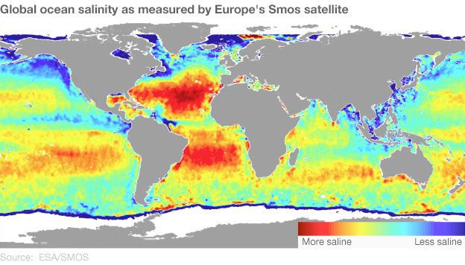
Movement in deeper ocean layers
Varying ocean salinity due to differences in freshwater inputs

Slide 13
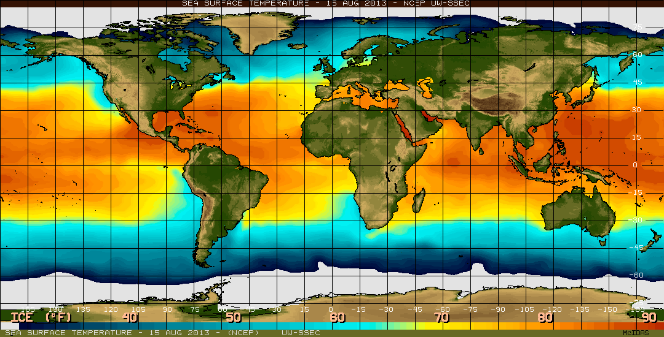
Movement in deeper ocean layers
Currents also occur in the deep ocean (1-5 km below sea-level)
Motion is caused by density caused by temperature and salinity differences
Thermohaline Circulation

Slide 15
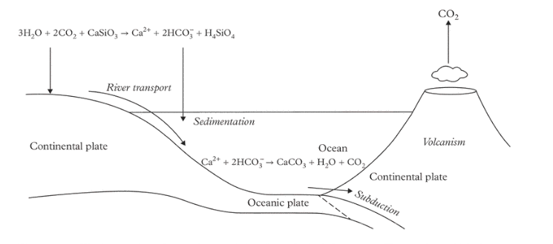
The ocean carbonate system

Slide 16
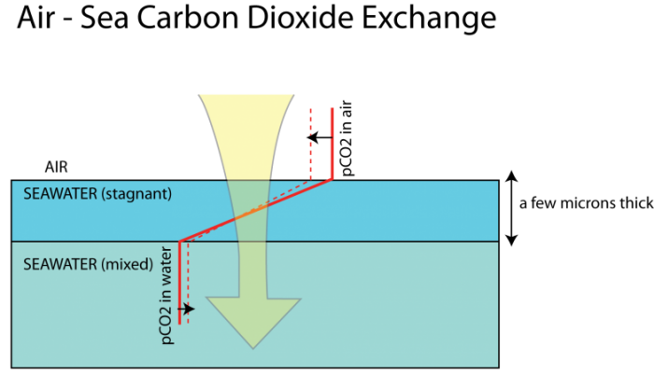
CO₂ from the atmosphere dissolves in sea water

Slide 17
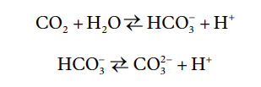
The ocean carbonate system
Bicarbonate
Hydrogen ion
Carbonate
Dissolved organic carbon (DIC) = CO₂ , HCO₃⁻ and CO₃⁻

Slide 18
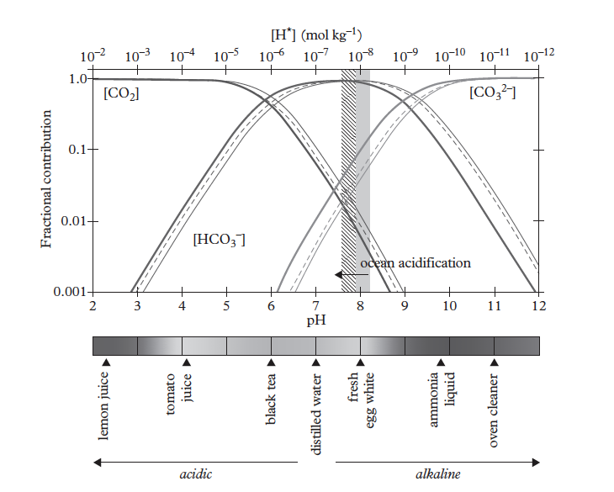
The balance of carbonate reactions depends on water pH
Notes:
Dolman, Han. (2019). <i>Biogeochemical Cycles and Climate.</i> Oxford University Press. Retrieved from <br>https://app.knovel.com/hotlink/toc/id:kpBCC00001/biogeochemical-cycles/biogeochemical-cycles

Slide 19
The balance of carbonate reactions depends on DIC concentrations
More dissolved CO₂ pushes the reaction towards producing more hydrogen ions, thereby changing water pH

Slide 20
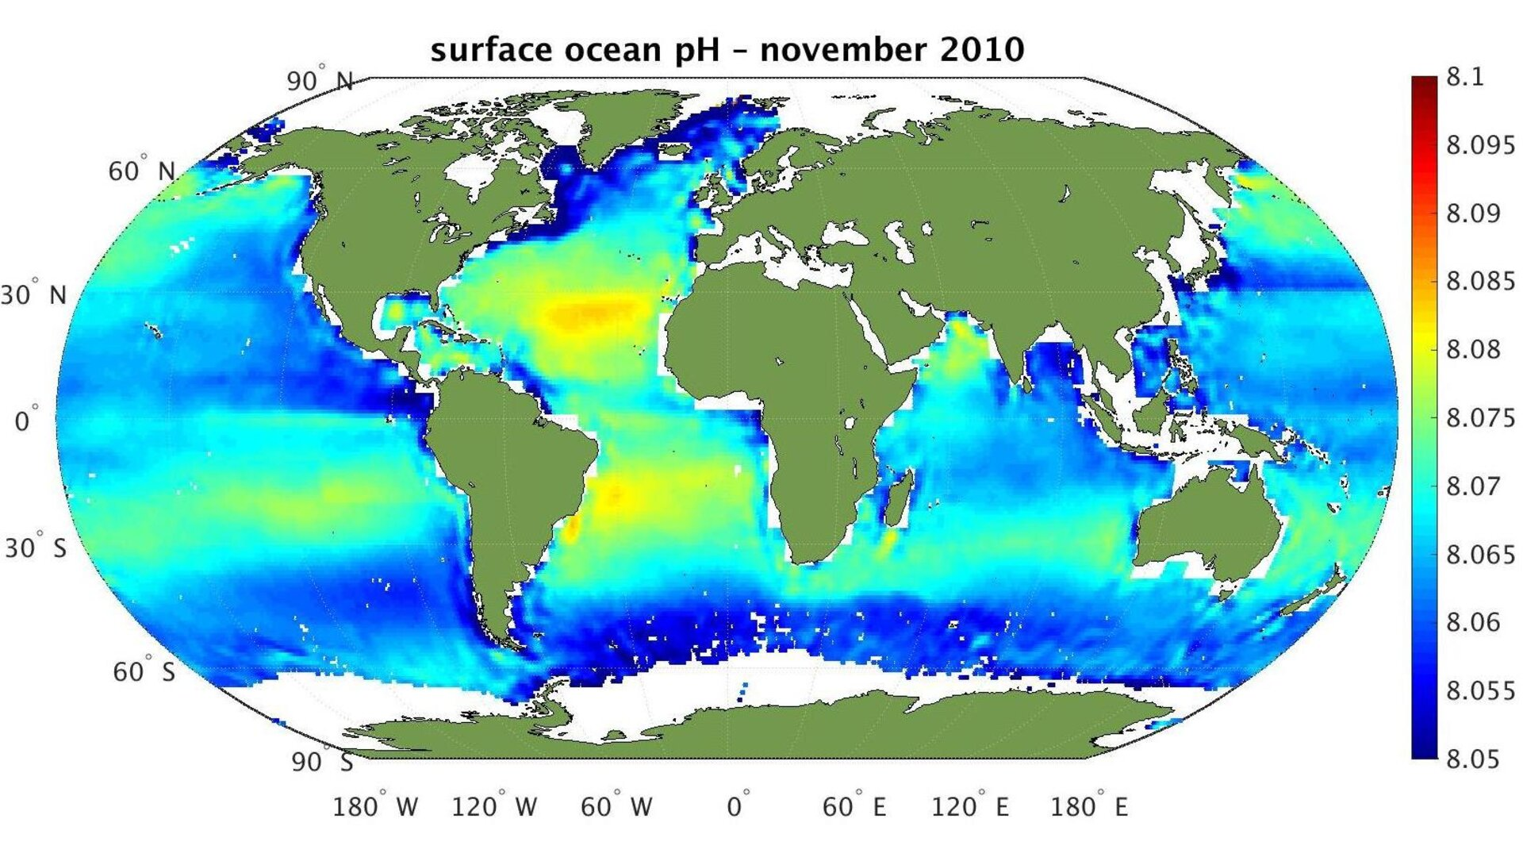
Ocean pH varies naturally driven by salinity and temperature

Slide 21
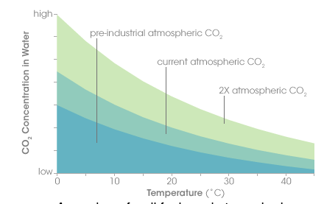
Dissolved CO₂ in ocean water depends on temperature
As the ocean temperature increases, the amount of carbon dioxide that can be dissolved decreases
Notes:
https://earthobservatory.nasa.gov/features/OceanCarbon

Slide 22
Vertical water movement: upwelling and downwelling can mix surface water with deep water

Slide 23
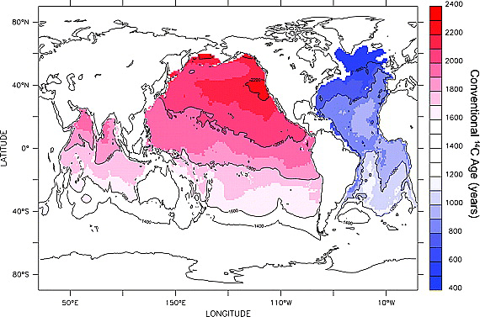
Vertical mixing is a very slow process compared to increases in atmospheric CO₂

Slide 24
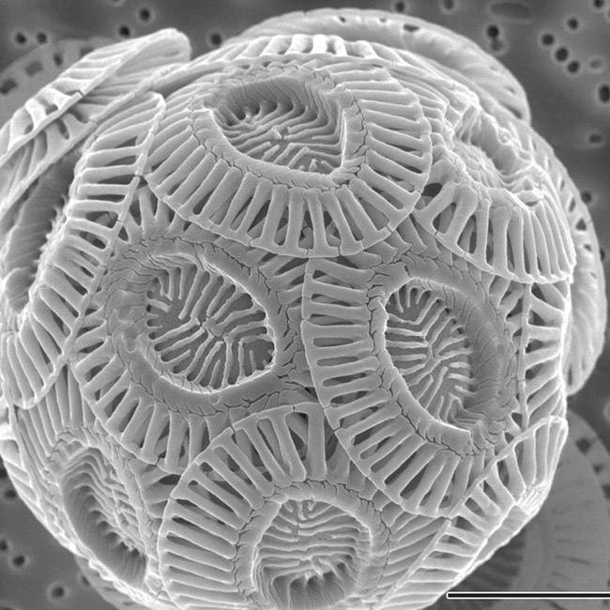
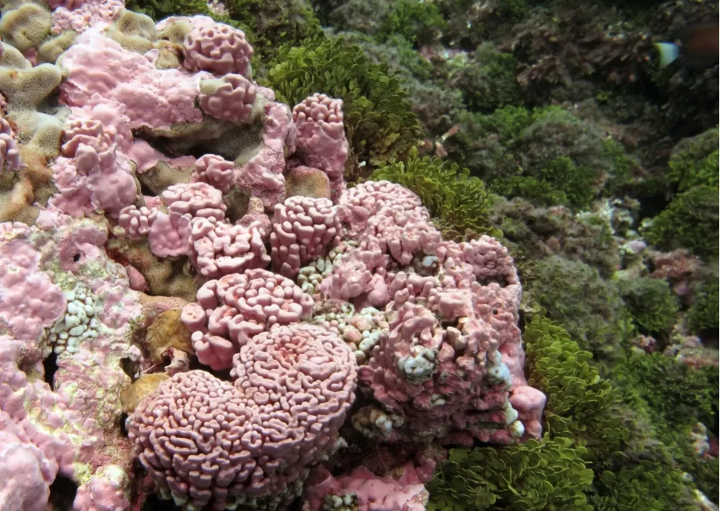
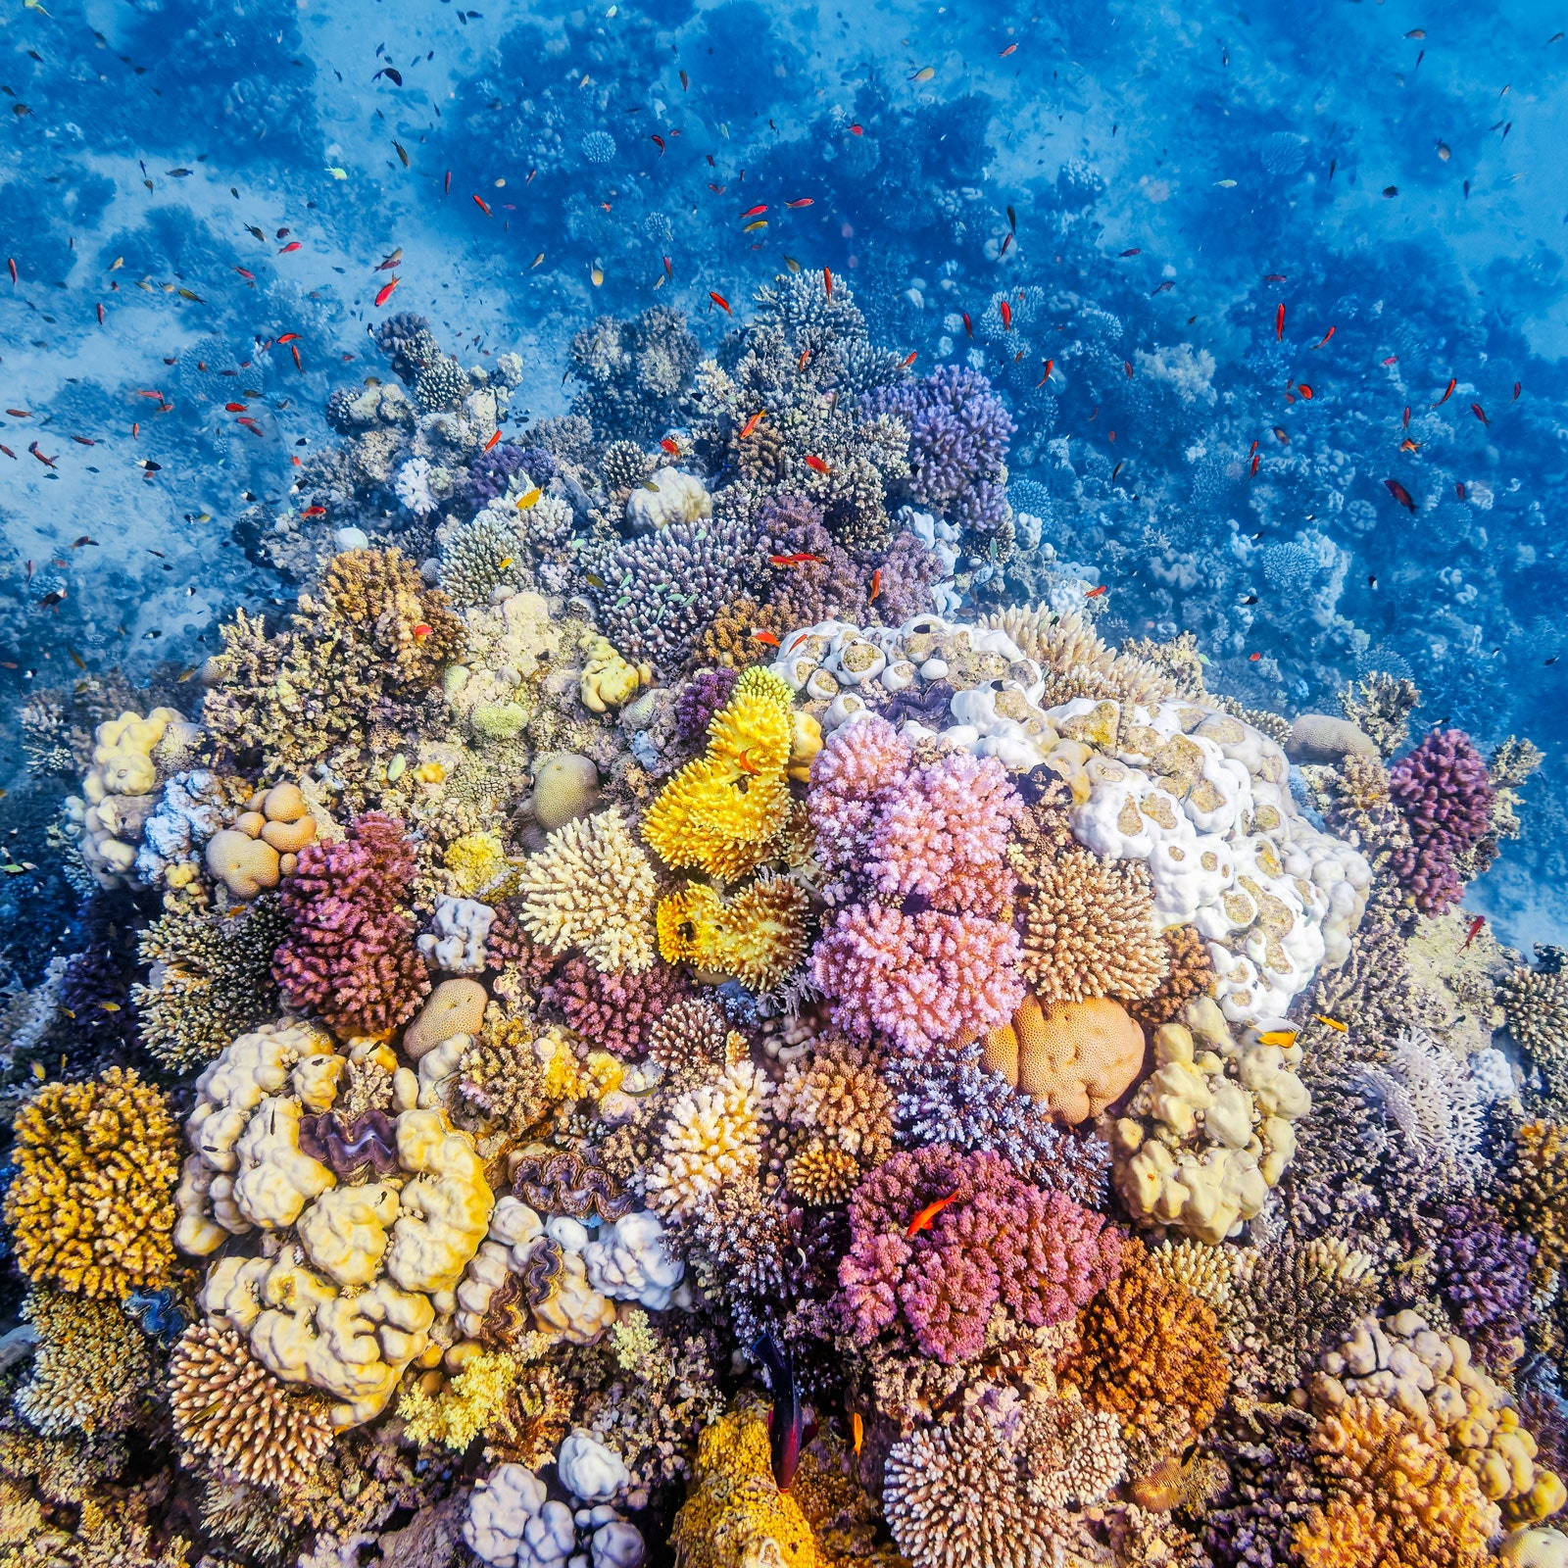
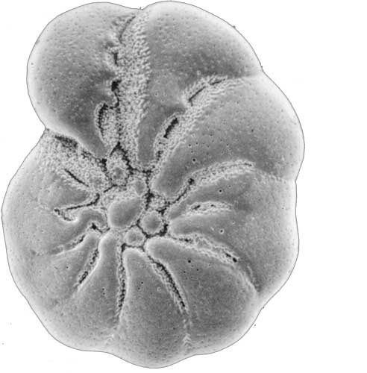
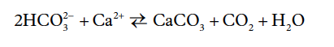
Biogenic carbonates
Coraline algae
Coccolithophores
Foraminifera
Corals
Organisms that use carbonate dissolved in sea water to form hard shells

Slide 25
Biogenic carbonates
Carbonate as calcite, magnesium calcite or aragonite

Slide 26
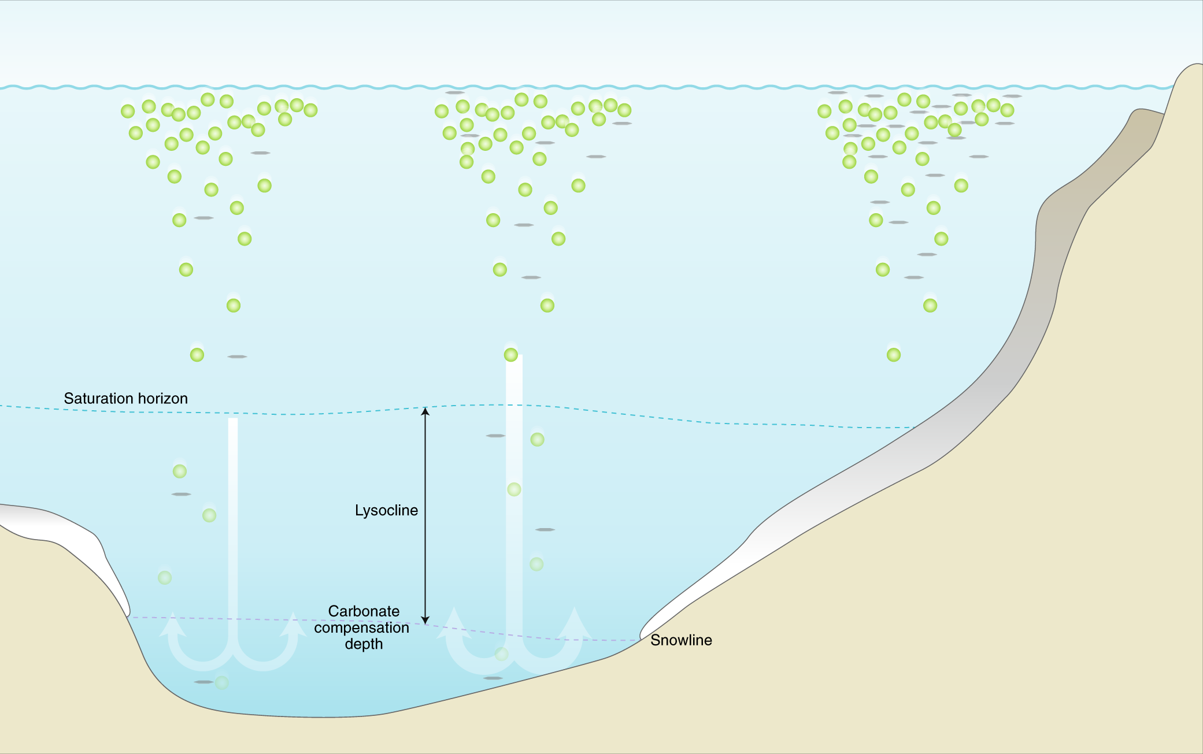
Carbonate shells sink to sediment
Dissolved carbonate remains in surface layer while calcium carbonate shells sinks to the ocean floor
This carbon accumulation in the ocean sediment is a slow process over millions of years

Slide 27
The availability of carbonate for shell formation depends on pH

Slide 28
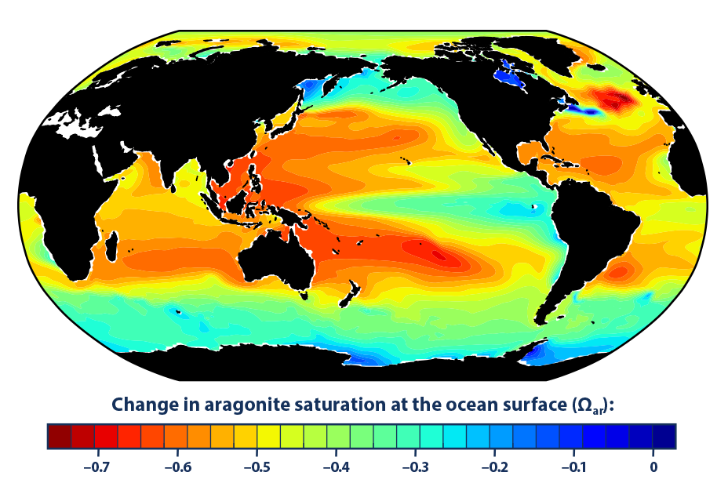
Changes in aragonite concentration
Notes:
https://www.jstor.org/stable/24861022

Slide 30
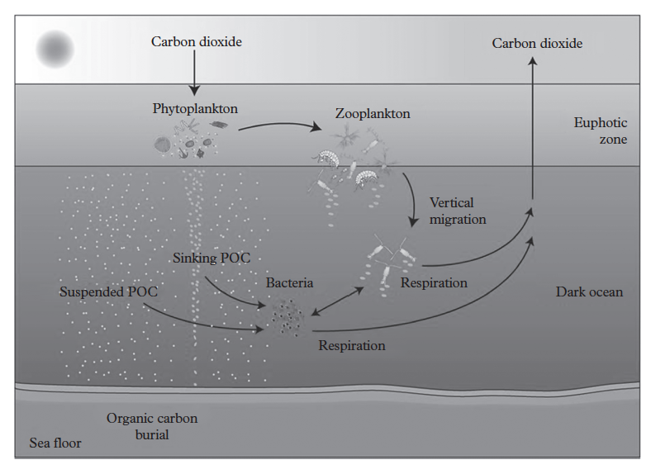
The biological carbon pump

Slide 31
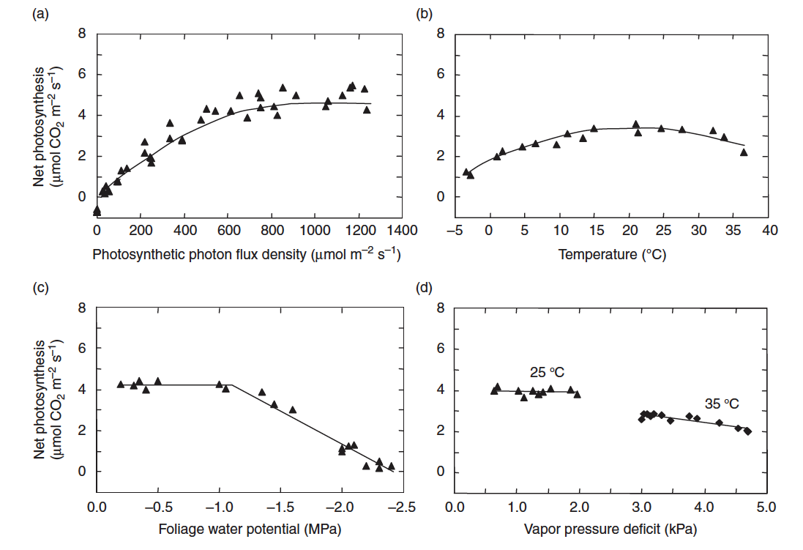
Terrestrial photosynthesis environmental drivers

Slide 32
Ocean photosynthesis environmental drivers

Slide 33
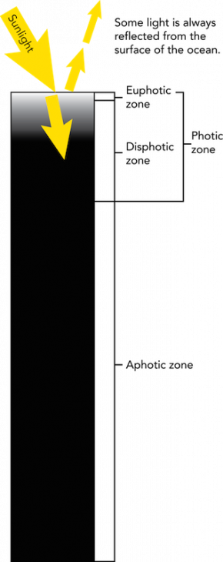
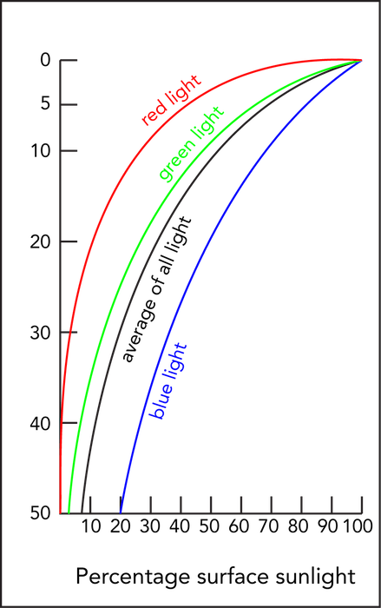
Light availably
Light for photosynthesis only in the euphotic zone
Blue light penetrates deeper into the disphotic zone

Slide 34
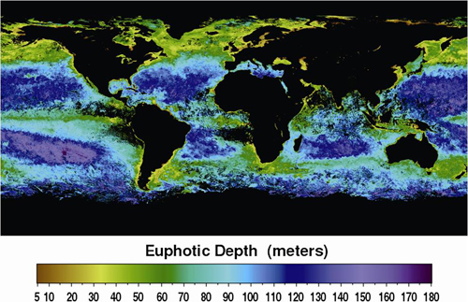
Euphotic depth

Slide 35
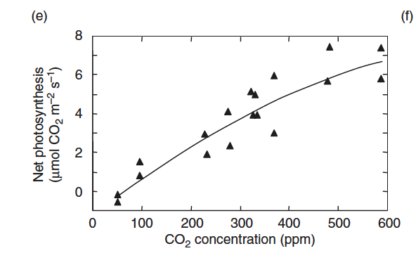
No CO₂ limitation due to large availability in surface waters

Slide 36
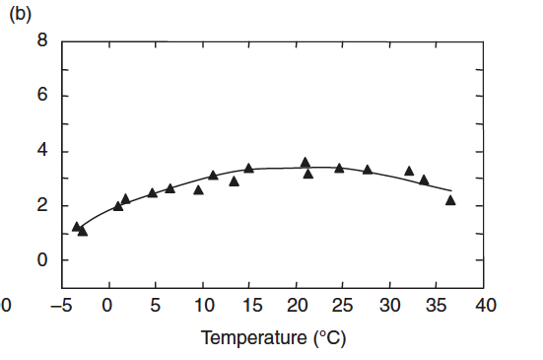
Temperature dependency

Slide 37
Oxygen constraints
Oxygen cycles between photosynthesis and respiration processes and is abundant in well mixed waters.
Physical obstructions to flow (e.g. fjords, closed seas) can cause anoxic or dead zones
An imbalance between autotrophs and heterotrophs can also lead to temporary anoxic zones

Slide 38
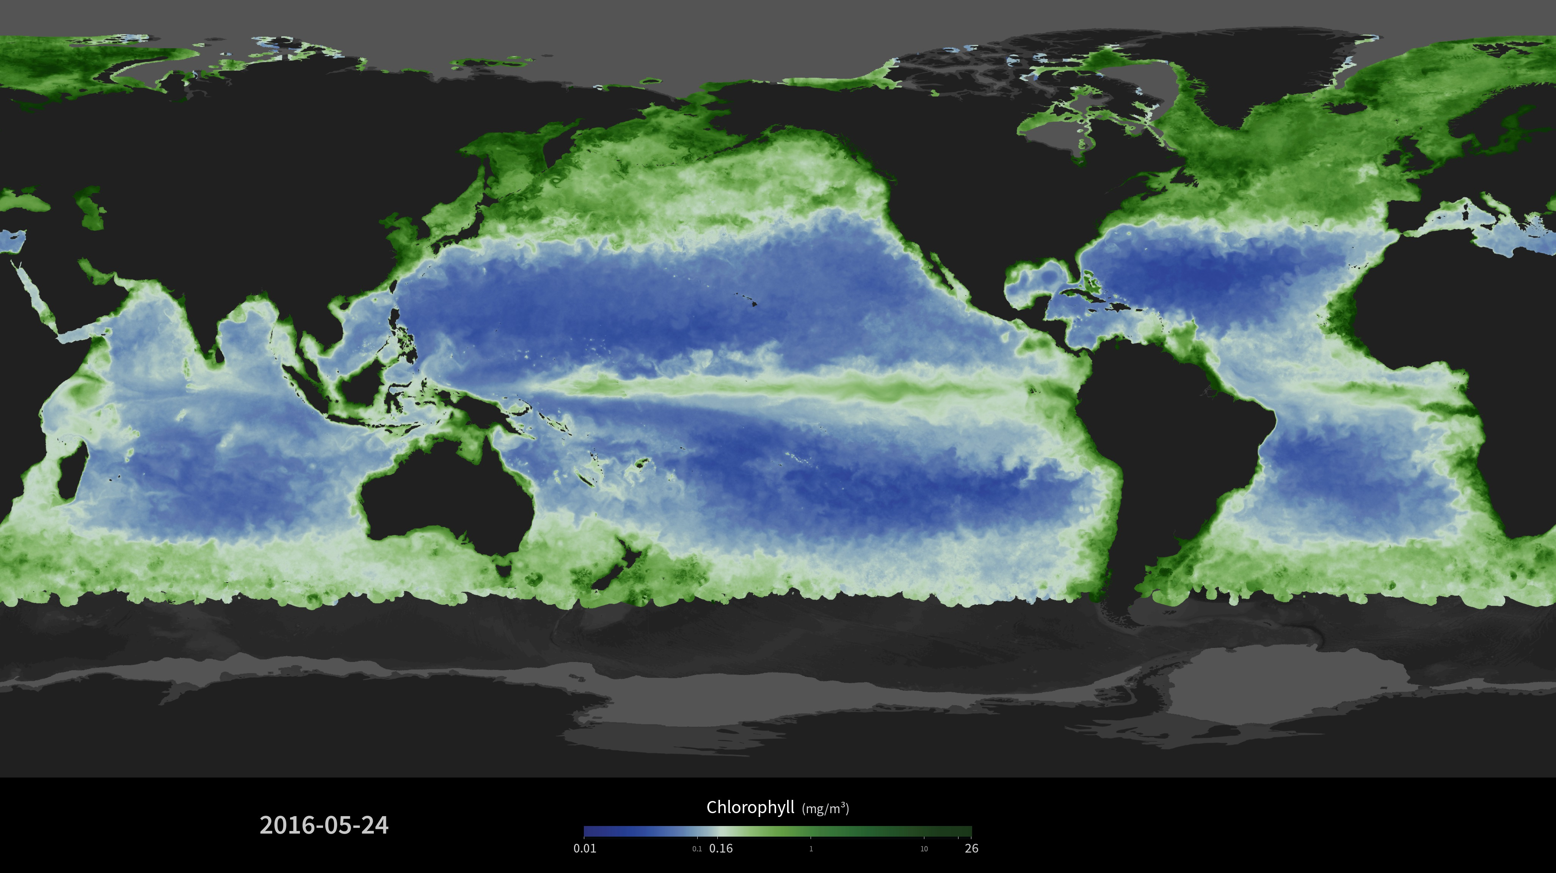
Global chlorophyll distribution

Slide 39
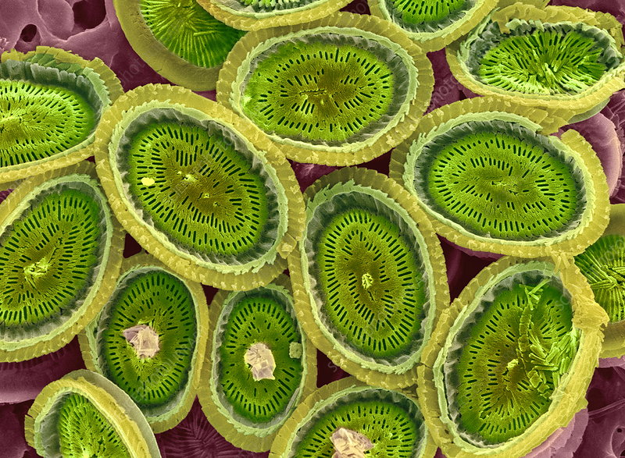
Nutrient limitation to plankton growth
C
P
Growth
N
Fe
Nutrients are the building blocks for new growth. The lack of any of them can mean less or no growth

Slide 40
Global chlorophyll distribution
More phytoplankton in well mixed regions or areas of upwelling

Slide 41
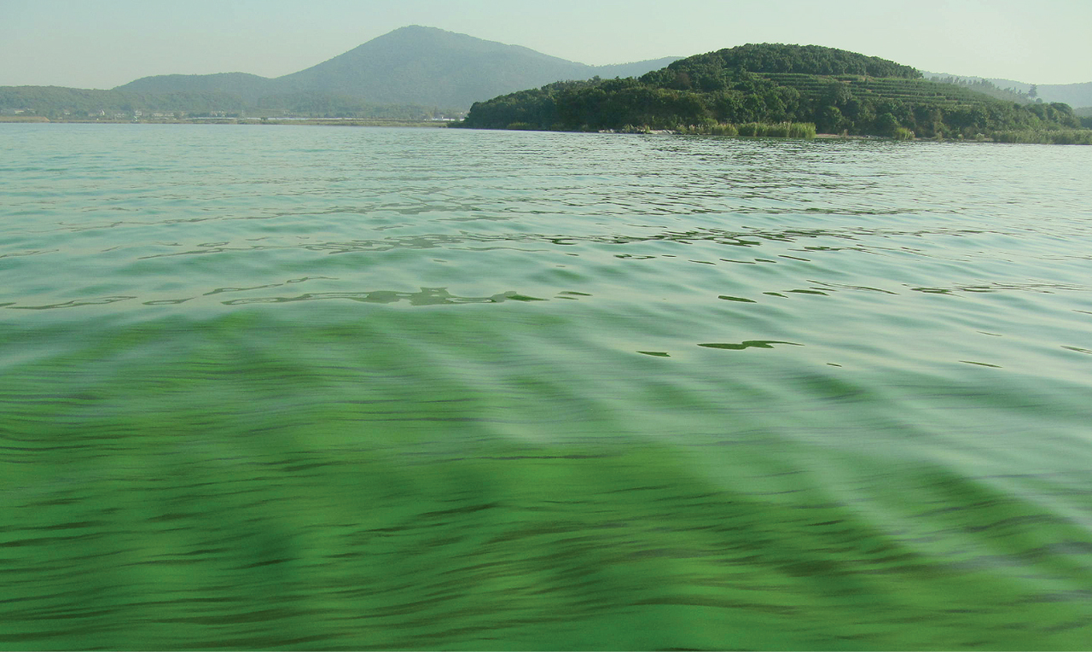
Algal blooms
Large inputs of nutrients (e.g. from sewage) can lead to sudden increases in algal growth.
Oxygen is depleted in lower levels from bacteria decomposing dead algal material

Slide 42
The biological carbon pump

Slide 43
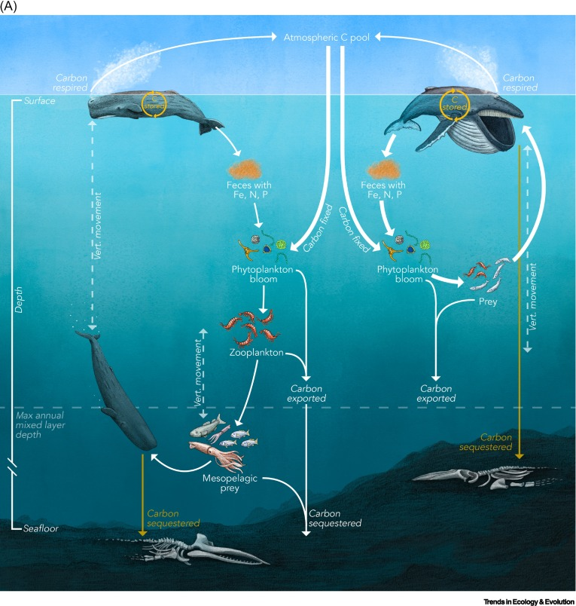
Carbon burial: migration pump
Notes:
https://www.cell.com/trends/ecology-evolution/fulltext/S0169-5347(22)00279-8?ref=sparrow.science

Slide 45
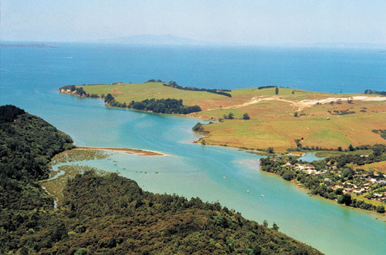
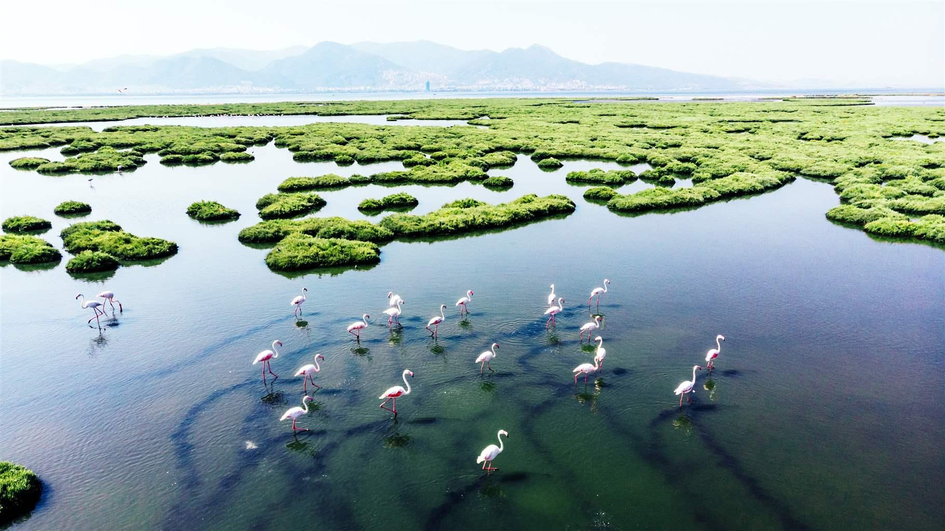
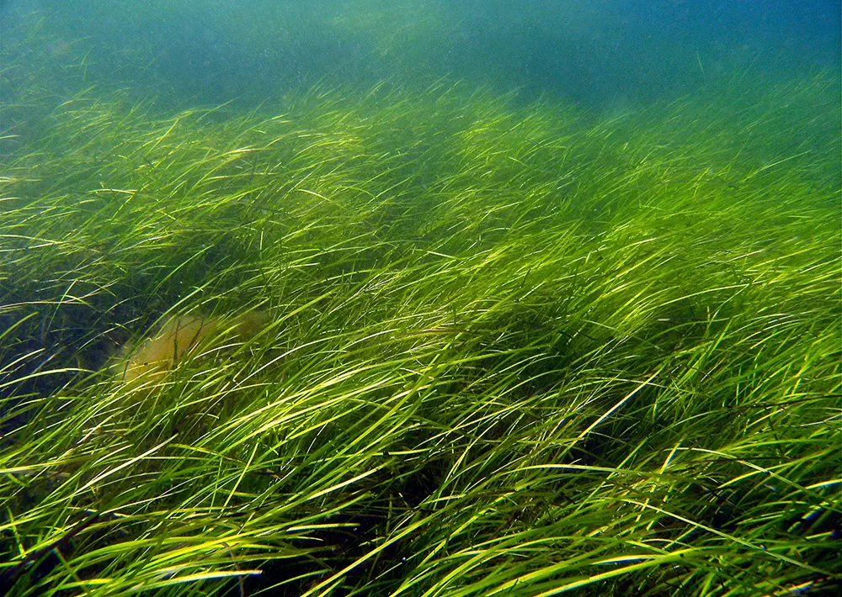
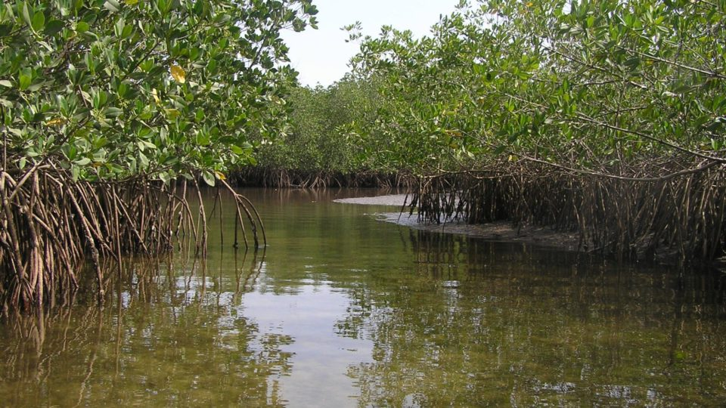
Blue carbon
Estuaries
Tidal and salt marshes
Seagrass ecosystems
Mangroves

Slide 46
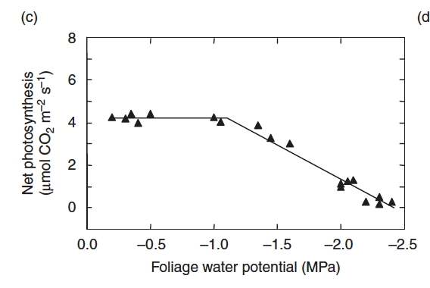
High terrestrial productivity

Slide 47
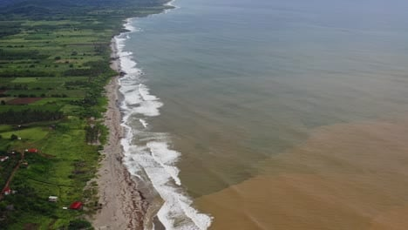
Input of organic matter from rivers
Dissolved organic matter flows into coastal waters

Slide 48
Higher productivity in coastal waters due to high nutrient availability

Slide 49
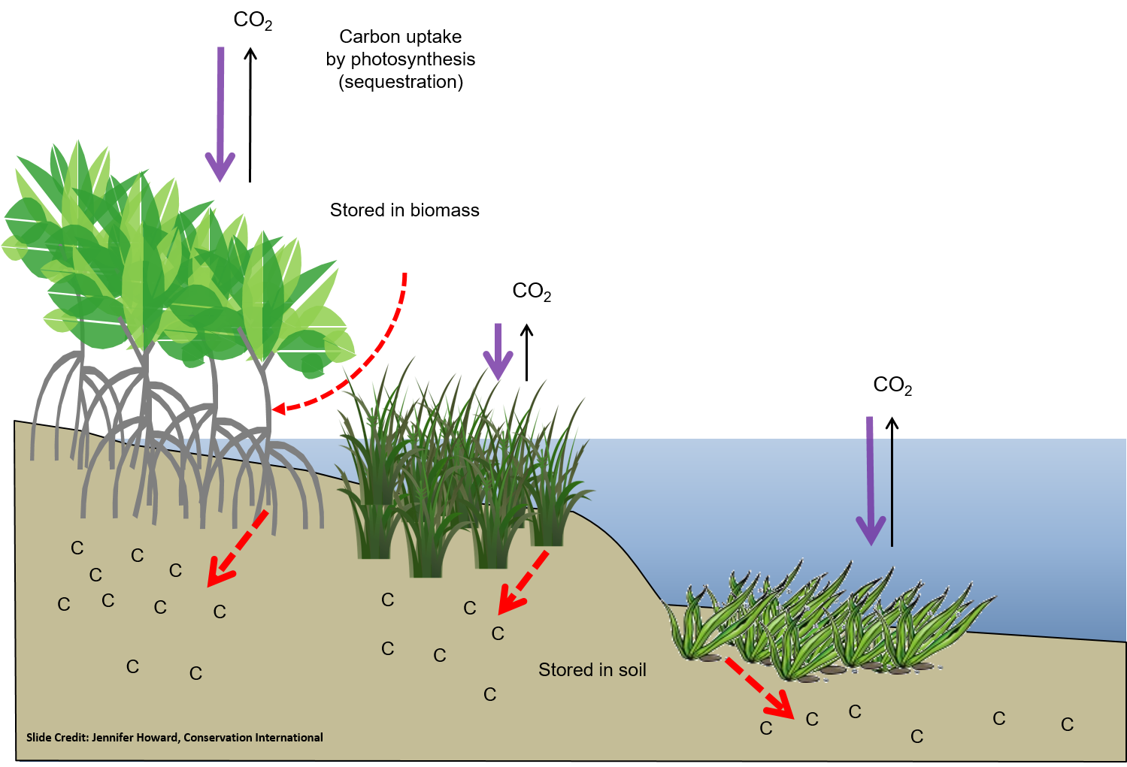
Carbon storage in soil and sediments

Slide 50

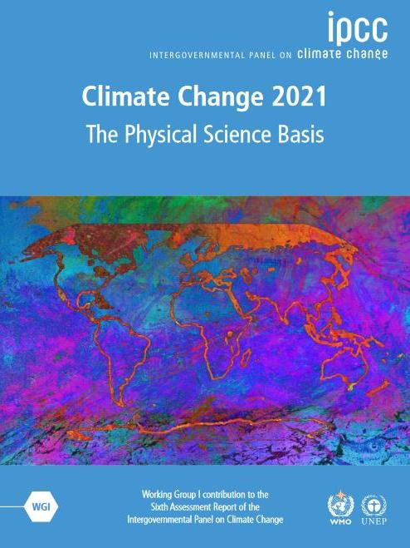
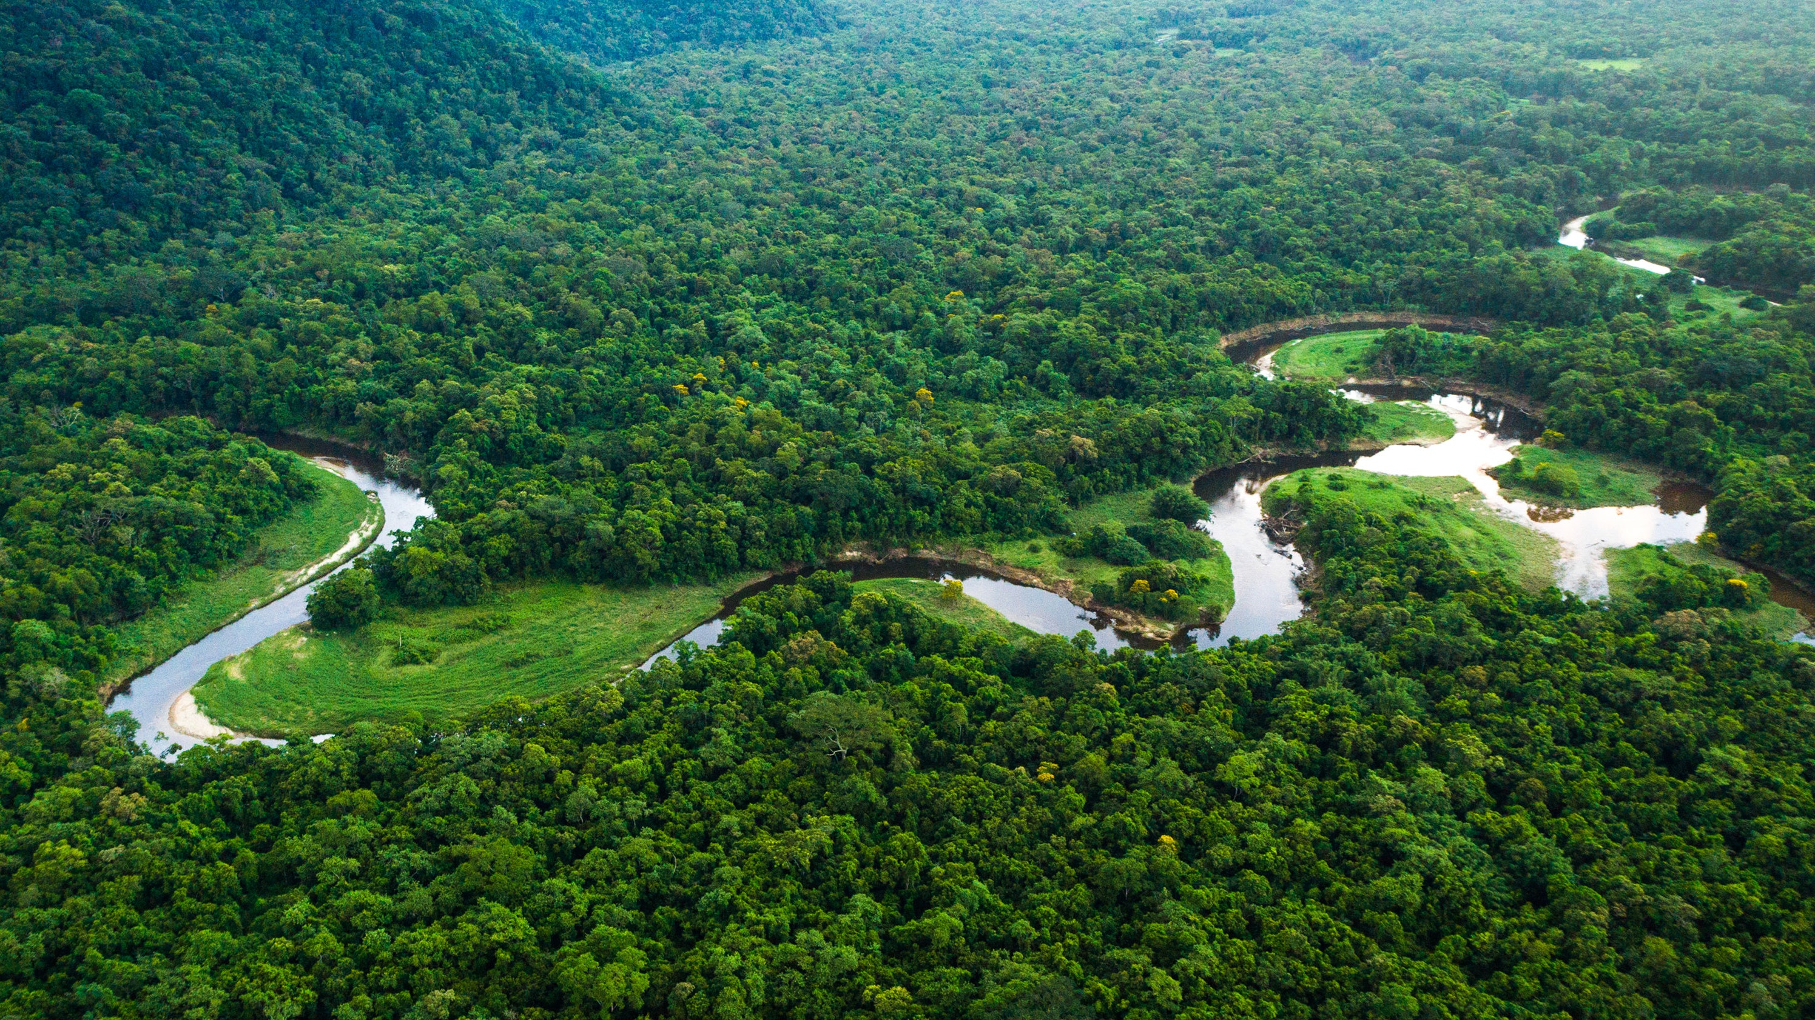
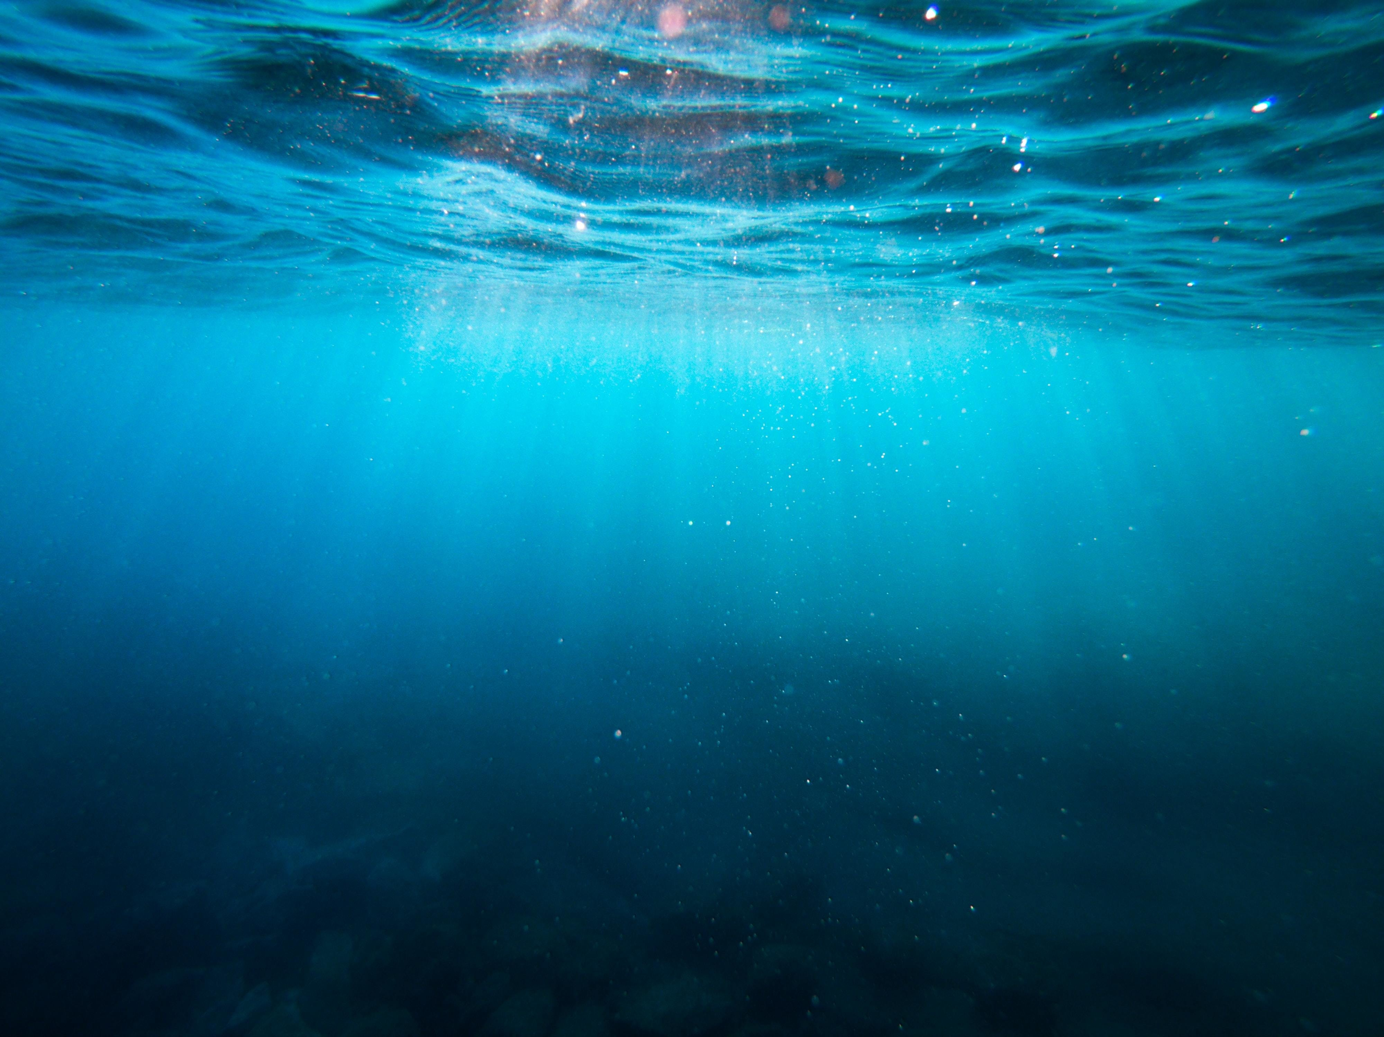
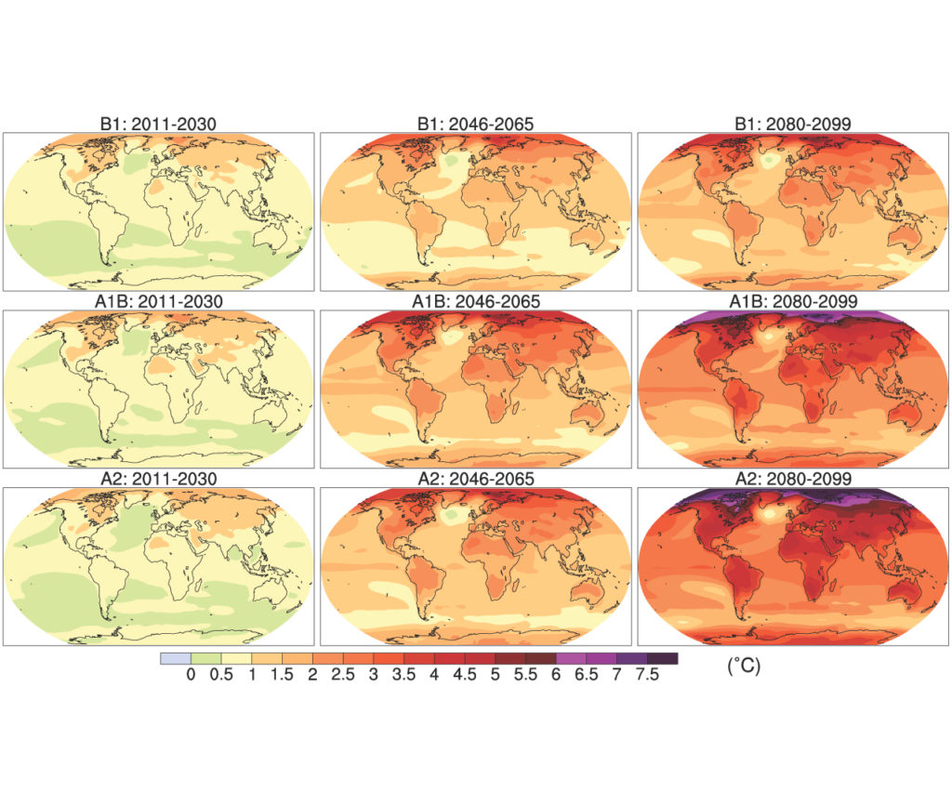
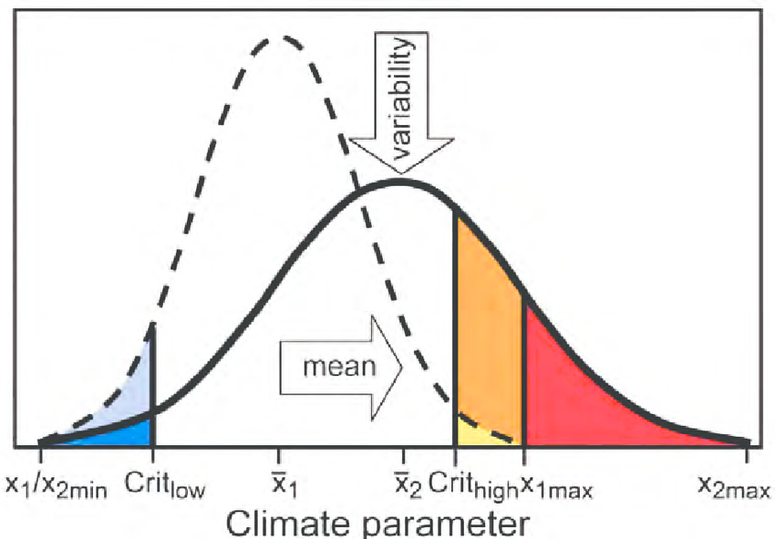
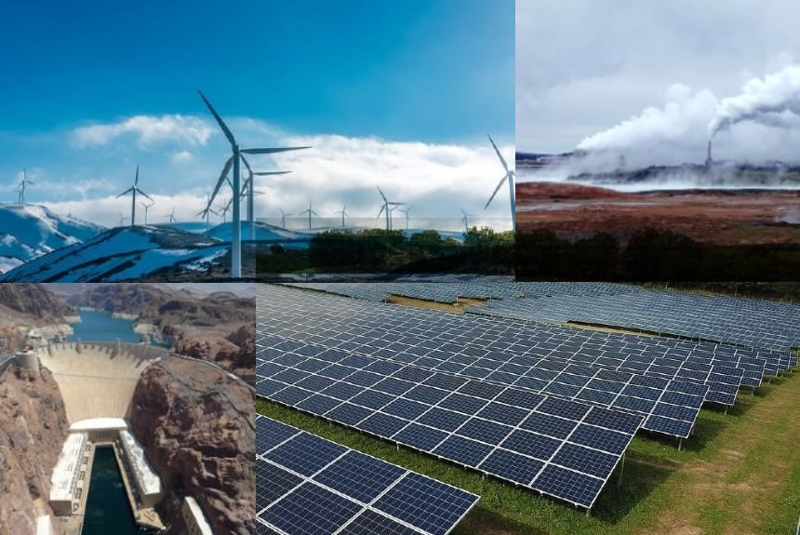
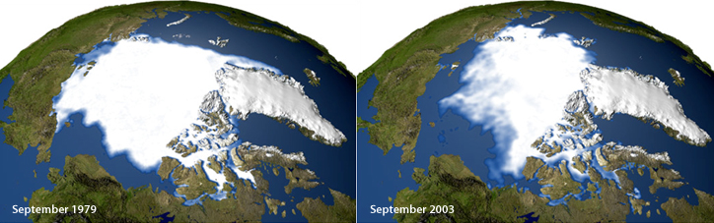
Atmosphere
Climate fundamentals
Predicting climate
Atmosphere
Global C cycle
IPCC report
Earth system models
Climate impacts
Climate solutions
Extreme events
Tipping points
Sea ice, ice caps,
Energy
Mitigation
Nature-based solutions

